Slide 1
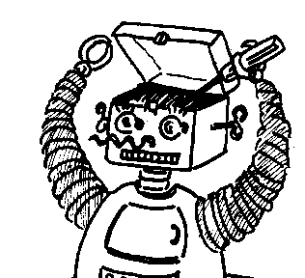
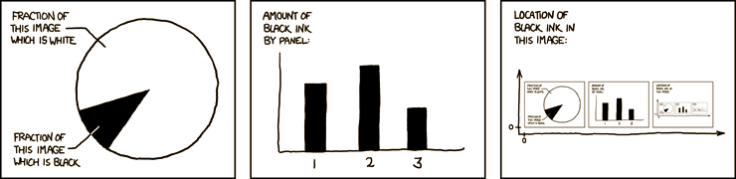

Maryland Metacognition Seminar
http://xkcd.com/
Metacognition — a biased overview
Professor Don Perlis
Computer Science Department . University of Maryland
4 March 2011, 10:00 AM
A. V. Williams Bldg., RM. 3258
Abstract:
I will discuss metacognition from a variety of perspectives (logical, philosophical, psychological, linguistic, neurological, and computational). In addition, I will describe how my own group's work has evolved in the pursuit of robust flexible self-adjusting autonomous agents.

